Slide 1

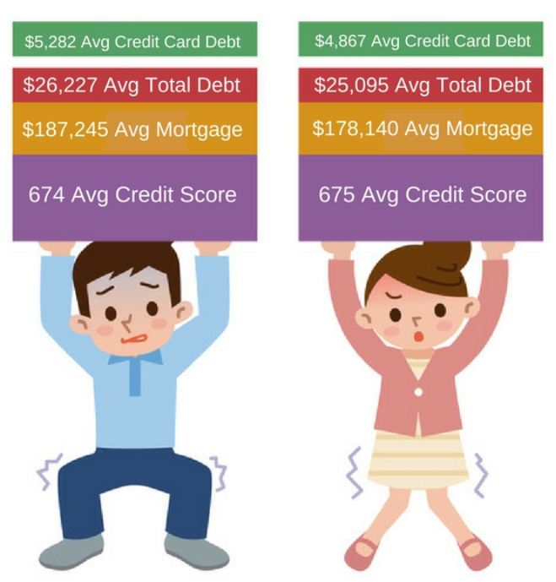
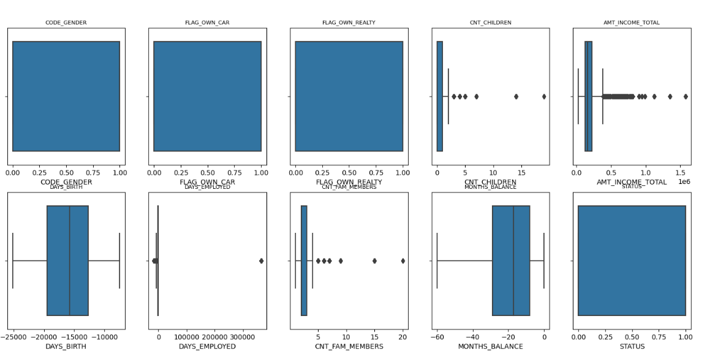

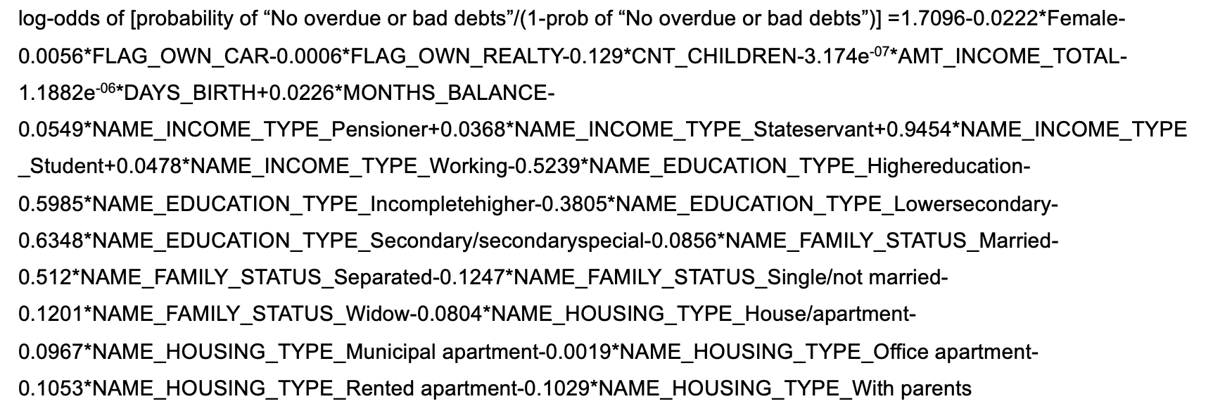
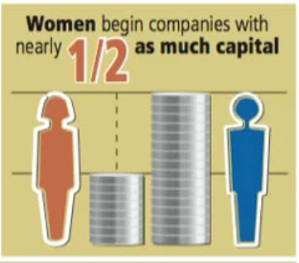
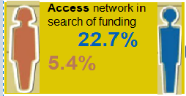
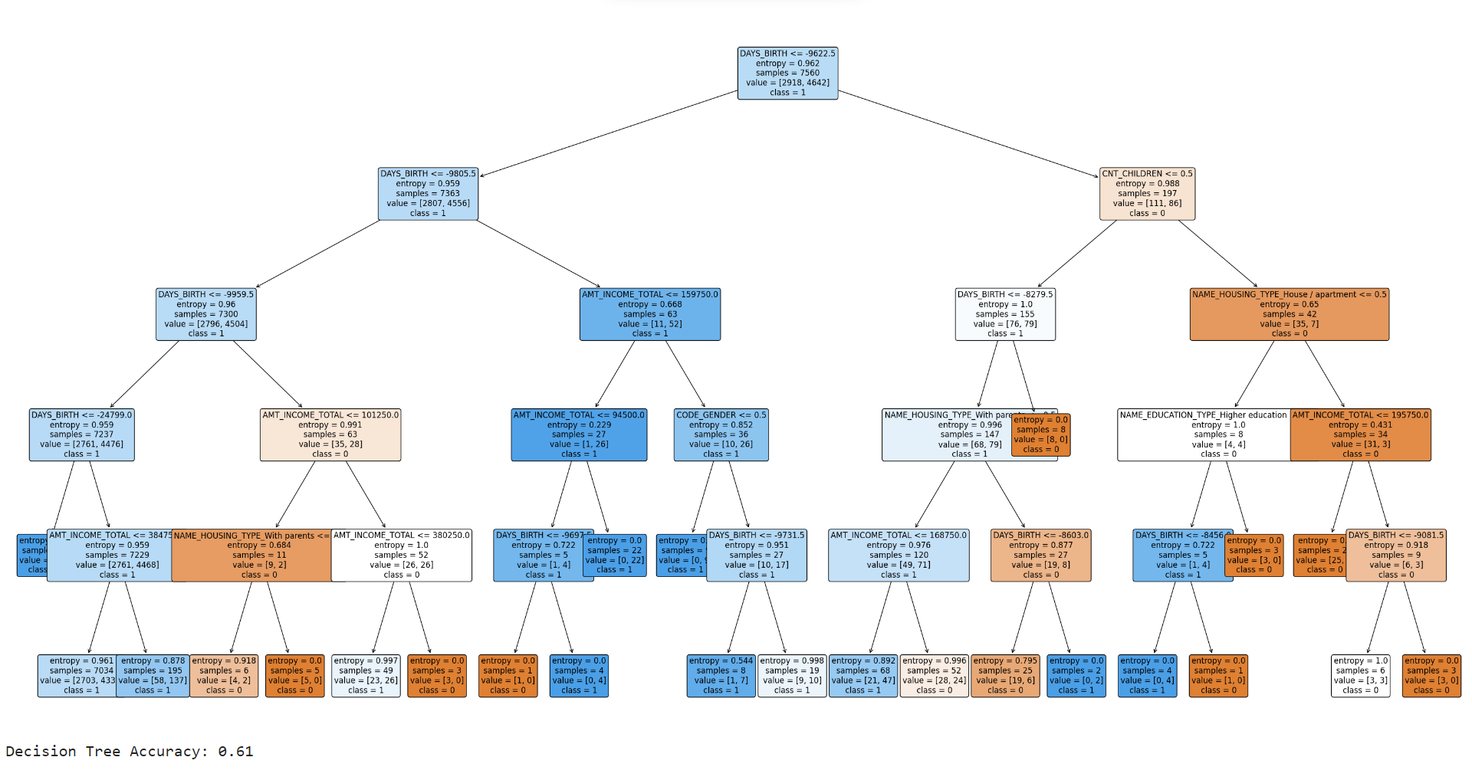
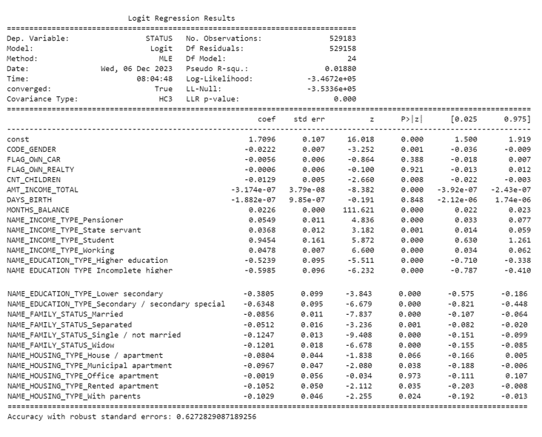
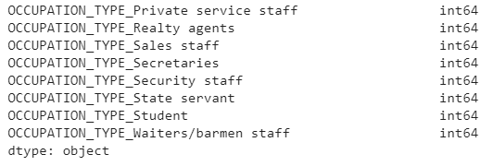
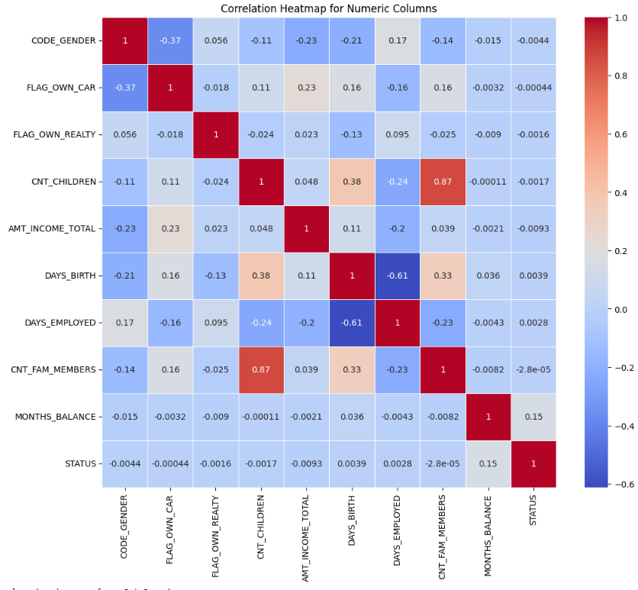
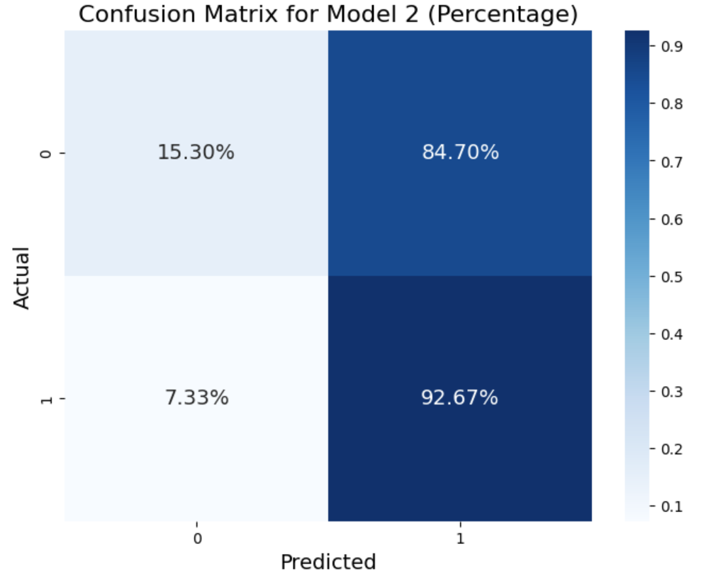
ARE FEMALE CREDIT-CARD CUSTOMERS DEFAULTERS?
Group 8
Ephraim Chang 23423584, Yiwen Liao 24044157, Harini Mittal 23367489
Background
Methodology (continued)
Methodology (continued)
Methodology (continued)
Historically, the financial landscape was characterized by gender-based discrimination, with women facing significant hurdles in obtaining credit. According to Investopedia.com, women on average have lower debt across all types of credit than men, yet have more credit cards, and almost the same credit score as men.
3) Outliers
Box plots and histograms were created to visualize outliers. Z-scores were then used to identify and remove these outliers from the data. For the Z scores, we dropped any observations that were more than 3 standard deviations above or below the mean.
7) Multicollinearity
To avoid multicollinearity, we dropped the independent variables 'CNT_FAM_MEMBERS’, and 'DAYS_EMPLOYED’ due to high correlation with 'CNT_CHILDREN’, and 'DAYS_BIRTH’ respectively.
8) Training and Testing Data
We split the dataset into training and testing data using a 70:30 ratio.
9) Logistic Regression Model on Training Data
Our dependent variable was ‘STATUS’ and main independent variable was ‘CODE_GENDER’. There were 10 other independent (control) variables when converted to dummy variables resulted in 23 variables excluding ‘CODE_GENDER’.
10) Heteroskedasticity
The p-value from the Breusch-Pagan test was less than 0.05, indicating the presence of heteroskedasticity.
11) Robust Logistic Regression Model
We fitted the logistic regression model on the training data with robust standard errors to correct for heteroskedasticity. The model's predictions on the test data were 62.8% accurate. The coefficient for female gender was significantly negative, indicating that changing the 'CODE_GENDER' variable from male (0) to female (1) decreases the log-odds of debts being repaid by 0.0222, holding all other variables constant.
13) Specificity, Precision, Recall, and F1 score
Specificity: 15.3% true negatives.
Precision: 63.4% true positives.
Recall: 92.8% times the model correctly identified the actual positive instances.
F1 Score: 0.752985044096246, harmonic mean of precision and recall indicating a reasonable overall performance.
14) F0.5 Score to Correct for Imbalance in Testing Data
F0.5 Score (= 0.6768635576551282) suggests that the model is reasonably effective at minimizing false positives, achieving a good balance between precision and recall, but with a higher emphasis on precision.
15) Main Findings of Logistic Regression
Our logistic regression model revealed that female gender was negatively related to the log-odds of STATUS in that increasing a female customer by 1 decreases the log-odds of debts being repaid by 0.0222 if all other independent variables are constant.
We found that the recency of the data by month, people with a higher number of children, persons from all types of housing or way of living except office apartments, and all kinds of education levels had a negative significant relationship with log-odds of debts being repaid.
People with all kinds of income types had a positive significant relationship with log-odds of debts being repaid. Although the amount of income had a negative significant relationship with log-odds of debts being repaid, the coefficient was extremely small, almost negligible.
16) Decision Tree Analysis
However, women earn less than men and have the responsibility for caring for children as single parents, having an impact on the women’s debt.
Their debt level is 39% as compared to 31% of men because of the income disparity. This has significant implications on other aspects of their lives such as delay in buying a home, getting married, having a child.
4) Dummy Variables
Created dummies for categorical variables:
'NAME_INCOME_TYPE’
'NAME_EDUCATION_TYPE’
'NAME_FAMILY_STATUS’
'NAME_HOUSING_TYPE’
Converted ‘STATUS’ into a binary variable:
0 for debts that were past due or bad
1 for debts that were either paid off or zero
5) Data Types
Used a “for” loop to recast the data type for dummies from “uint8” or “object” data types to “int64”.
Women have different financial behaviors and risk aversion compared to men. Given this background, there is a need to explore whether female credit card holders are less likely than male holders to have overdue or bad debts.
Objectives
Use a logistic regression model to understand if there is a correlation between gender and credit card debt status using the credit card dataset provided by Kaggle, to give suitable recommendations to a large commercial bank
Evaluate the impact of various factors, including but not limited to gender, on the likelihood of having overdue or bad debts
Include decision trees to validate/invalidate logistic regression results
Original Model
17) Methodology of the Decision Tree Model
We built decision trees with the same training and test variables as the logistic regression model except for ‘MONTH-BALANCE’ to understand the order of importance of the independent variables irrespective of the recency of data.
The model was programmed to choose the best values from 'max_depth': [5, 10, 15], and 'min_samples_split': [2, 5, 10].
The Max Depth that the program chose was 5.
Accuracy was 61%.
18) Main Findings of Decision Tree Analysis
Our analysis revealed that age was the most influential factor in predicting default risk, with younger customers (<26 years) influenced by the number of children and income.
Younger customers living with parents and aged under 22 showed no outstanding debt. Those without children had a 40.8% default chance if not living with parents and earning less than $168,750.
Customers with at least one child in an apartment and income below $168,750 had a 50% default chance, increasing to 91% with income below $195,750.
Notably, gender did not contribute to default prediction in the decision tree analysis.
log-odds of [P*/(1-P*)]= β₀ +
β₁ *Female+
β₂ *FLAG_OWN_CAR+
β₃ *FLAG_OWN_REALTY+
β₄ *CNT_CHILDREN+
β₅ *AMT_INCOME_TOTAL+
β₆ *DAYS_BIRTH+
β₇ *MONTHS_BALANCE +
β₈ *NAME_INCOME_TYPE_Pensioner+
β₉ *NAME_INCOME_TYPE_Stateservant+
β₁₀ *NAME_INCOME_TYPE_Student+
β₁₁ *NAME_INCOME_TYPE_Working+
β₁₂ *NAME_EDUCATION_TYPE_Highereducation+
β₁₃ *NAME_EDUCATION_TYPE_Incompletehigher+
β₁₄ *NAME_EDUCATION_TYPE_Lowersecondary+
β₁₅ *NAME_EDUCATION_TYPE_Secondary/secondaryspecial+
β₁₆ *NAME_FAMILY_STATUS_Married+
β₁₇ *NAME_FAMILY_STATUS_Separated+
β₁₈ *NAME_FAMILY_STATUS_Single/not married+
β₁₉ *NAME_FAMILY_STATUS_Widow+
β₂₀ *NAME_HOUSING_TYPE_House/apartment+
β₂₁ *NAME_HOUSING_TYPE_Municipal apartment+
β₂₂ *NAME_HOUSING_TYPE_Office apartment+
β₂₃ *NAME_HOUSING_TYPE_Rented apartment+
β₂₄ *NAME_HOUSING_TYPE_With parents
P* = Probability of “No overdue or bad debts”
6) Heatmap
Created a heatmap to identify independent variables that had high correlation.
12) Confusion Matrix
We created a confusion matrix using 'STATUS' as the dependent variable and all other variables (excluding the ID) as independent variables. The matrix revealed a higher number of false positives compared to false negatives. The testing dataset was determined to be imbalanced.
Confusion Matrix
[ 13426 74336 ]
[ 10194 128838 ]
Recommendations
Prioritizing financial literacy for women and younger customers to mitigate overdue debts
Mentoring women can have positive ripple effects while guiding younger customers can expedite debt management
Investing in tailored mentorship for both groups is prudent, offering long-term benefits. We encourage support-seeking from the bank for their financial decisions
Methodology
1) Files Merging
Merge the 'application_record' and 'credit_record' datasets into one data frame named 'joined_df’.
2) Null Values
After examining the data for null values, it was observed that there were missing entries in the 'OCCUPATION_TYPE' column. Instead of dropping these rows, the missing values in 'OCCUPATION_TYPE' were filled with the corresponding 'INCOME_TYPE' entries. Eventually, we dropped 'OCCUPATION_TYPE’ because it was redundant.
Limitations
High rate of false positives in the logit model
Omitted variable bias
Lower accuracy rates

